Slide 1
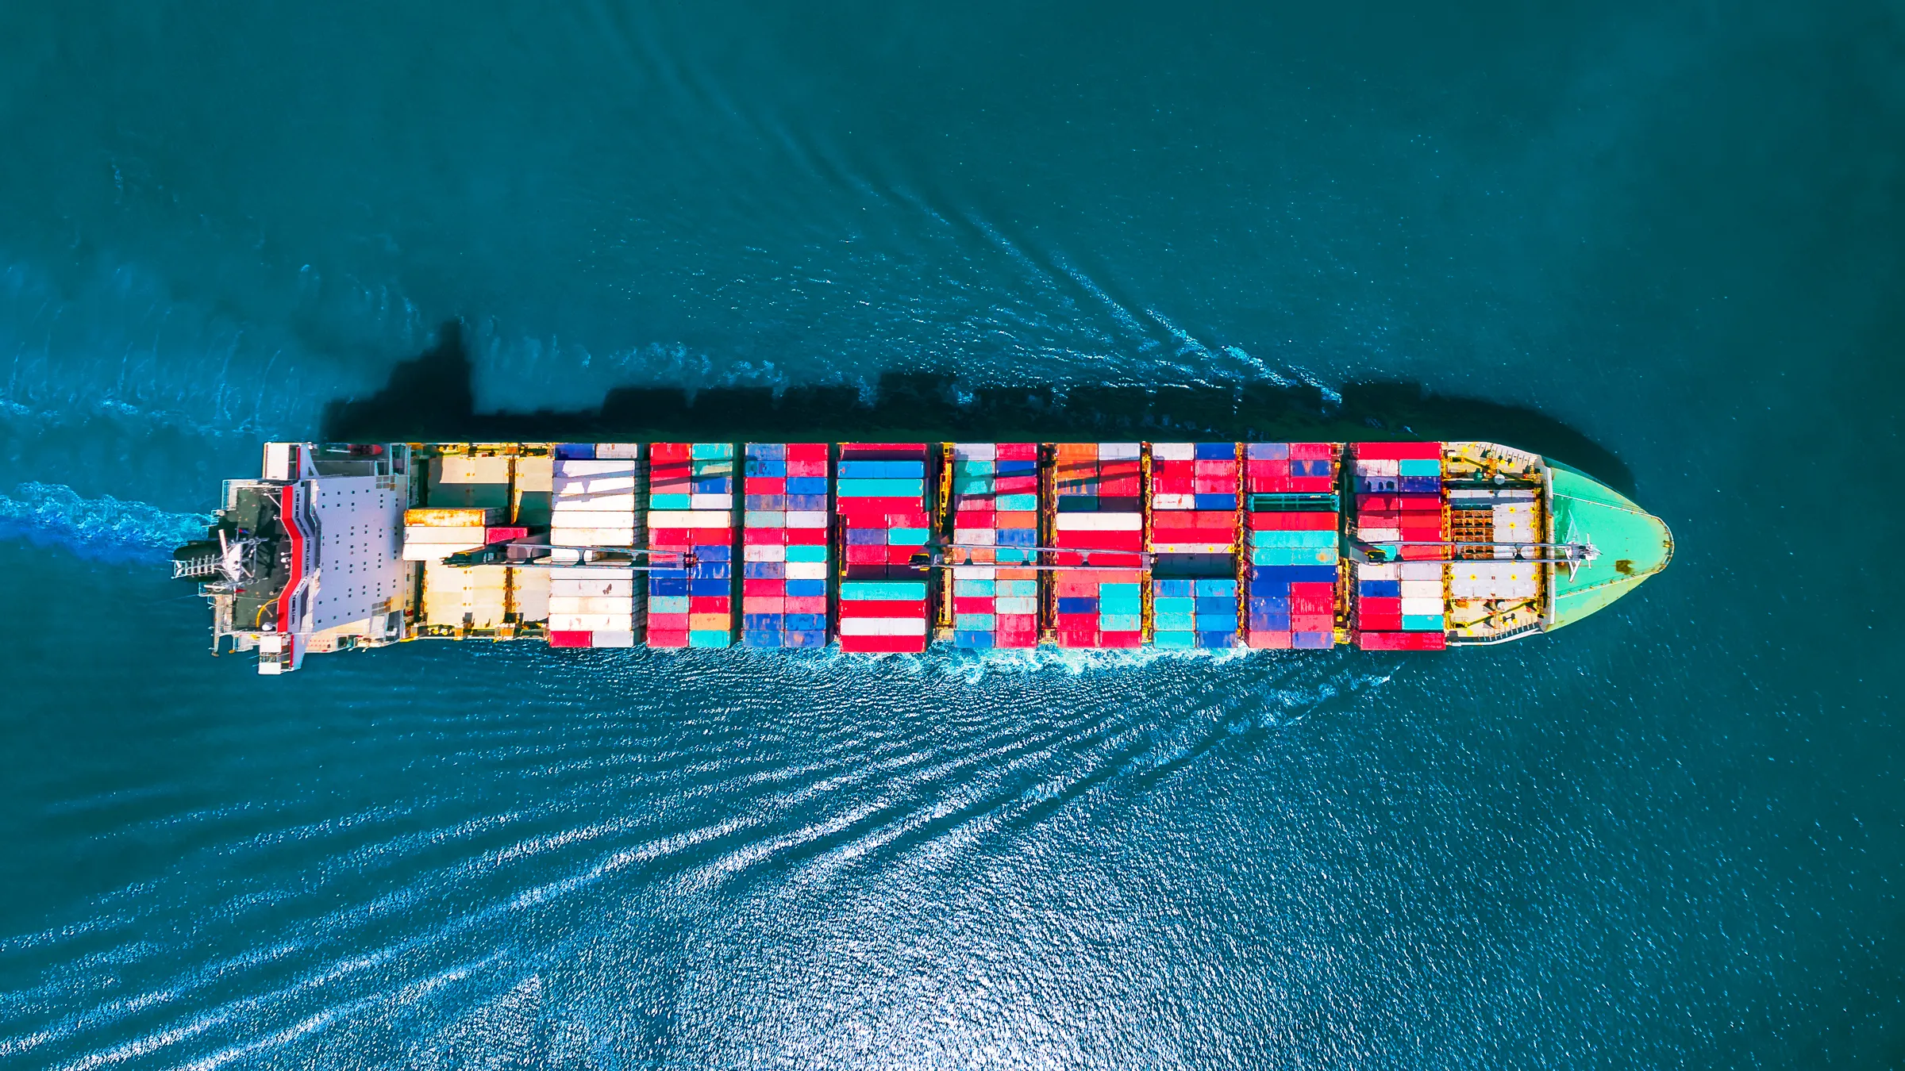
School Name
STEM Lesson 2 – Bulkheads
SCL

Slide 2
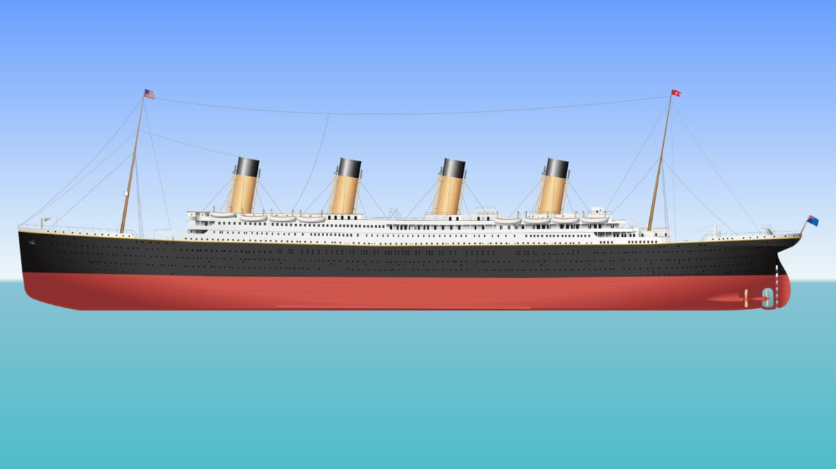
Titanic
NEW and IMPROVED! - Titanic - Death of a Titan - T.H.Cooney Art
SCL
Notes:
Show the video of the Titanic sinking.

Slide 3
Bulkheads in Titanic
SCL
Notes:
Explain that the Titanic had a revolutionary new shipbuilding technology known as bulkheads, designed to prevent sinking if one of the compartments was flooded.

Slide 4
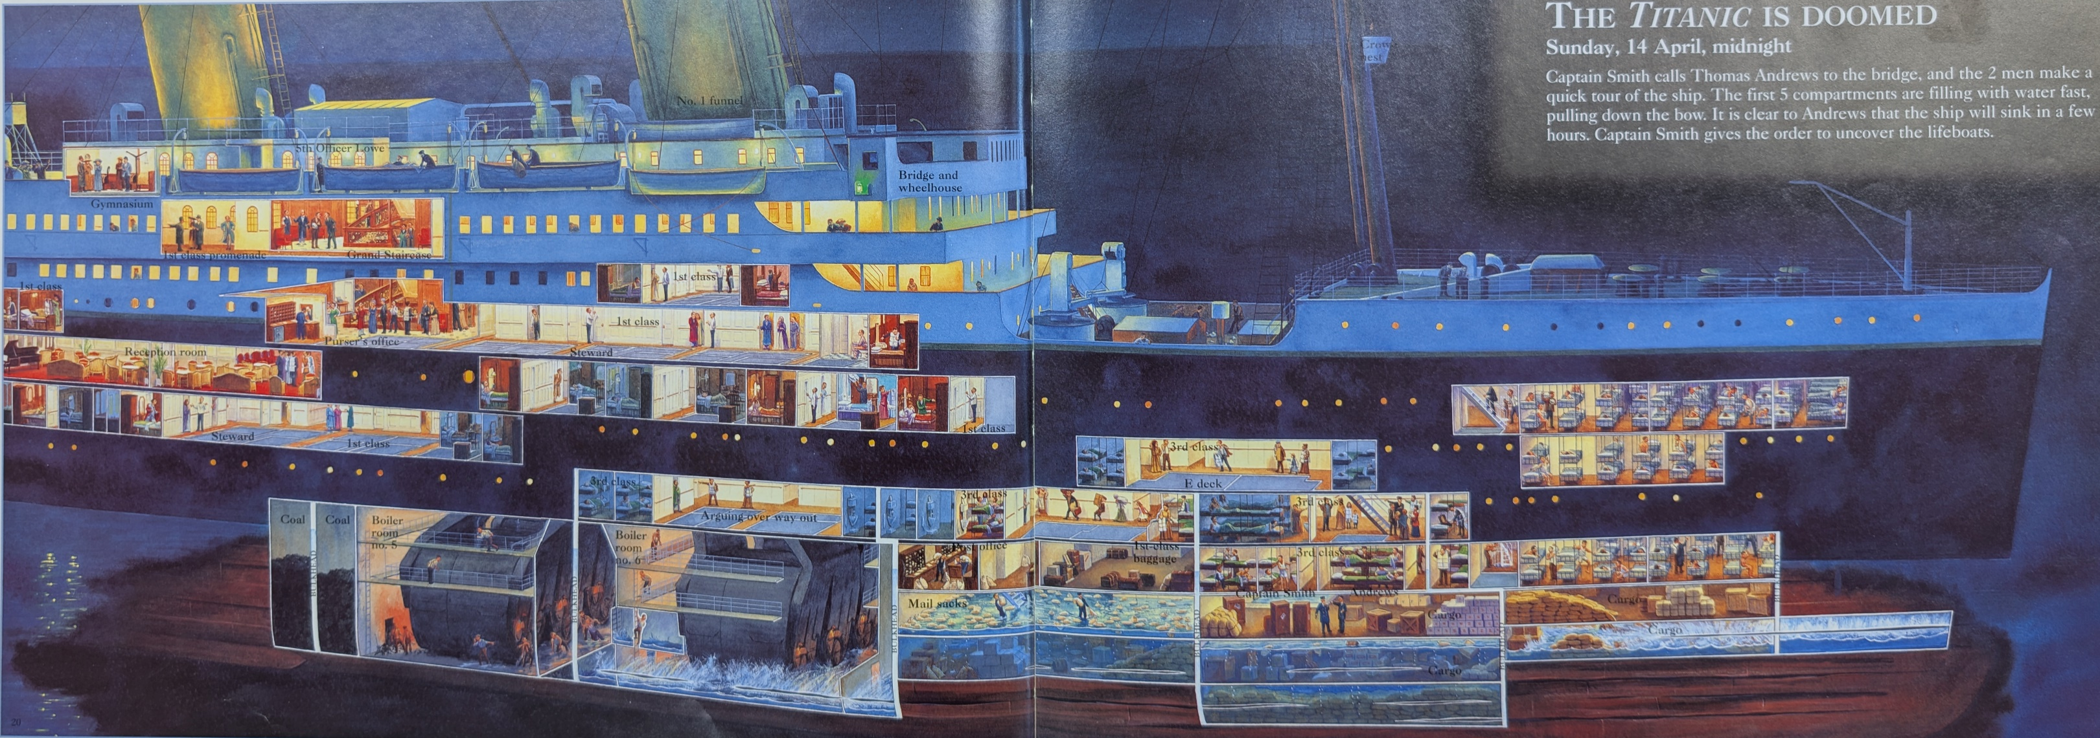
Bulkheads in Titanic
SCL
Notes:
Explain that when the Titanic hit the iceberg, five forward compartments flooded.

Slide 5
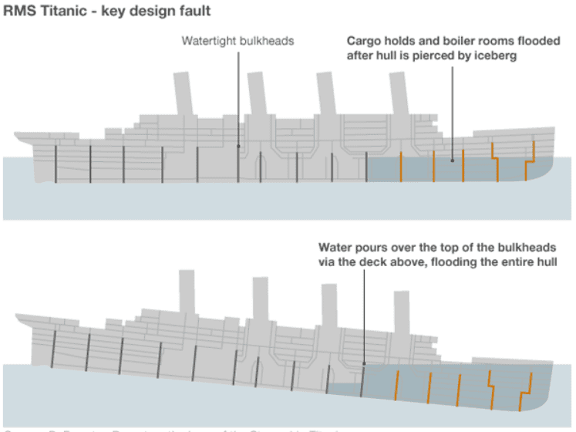
Bulkheads in Titanic
SCL
Notes:
Explain that as the forward section sank due to loss of buoyancy, it caused a chain reaction. Water was able to spill over the top of the bulkheads because they were not high enough.

Slide 6
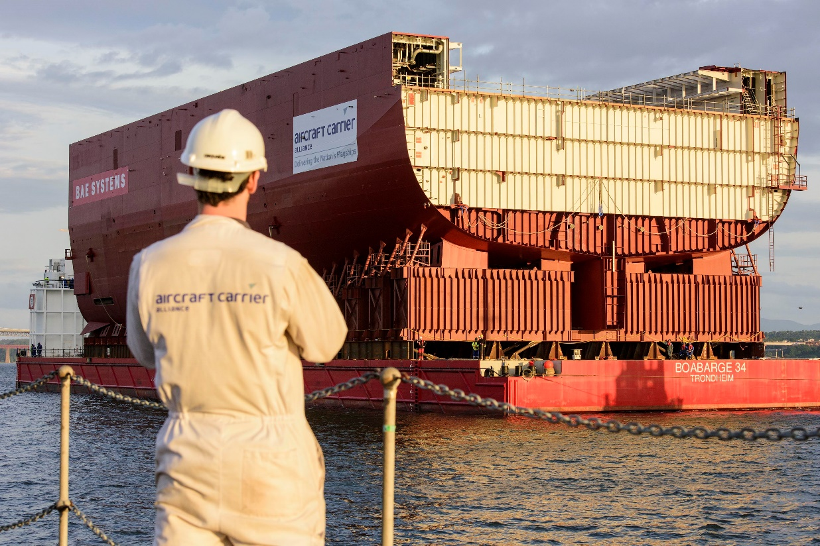
Bulkheads in Modern Ships
SCL
Notes:
Highlight that modern bulkheads now extend much higher up the ship and are often sealed at the top, as seen in the design of the HMS Queen Elizabeth aircraft carrier.

Slide 7
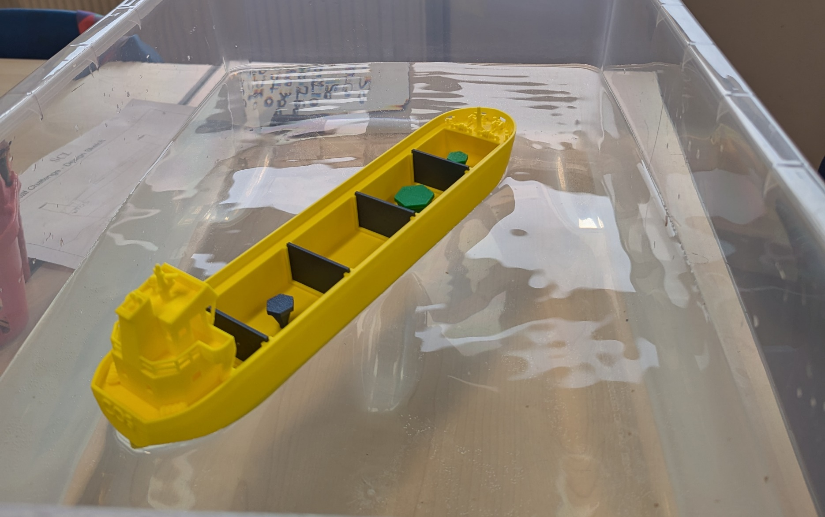
Bulkhead experiment
SCL
Notes:
Split up the class and begin the bulkhead experiment. Distribute the Bulkhead Worksheet to the students and start experimenting.

Slide 8
Recap
What is Buoyancy?
What are Bulkheads?
What cause the titanic to sink?
SCL
Notes:
After the experiment, ask the class what they have learned from the lesson.

Slide 9
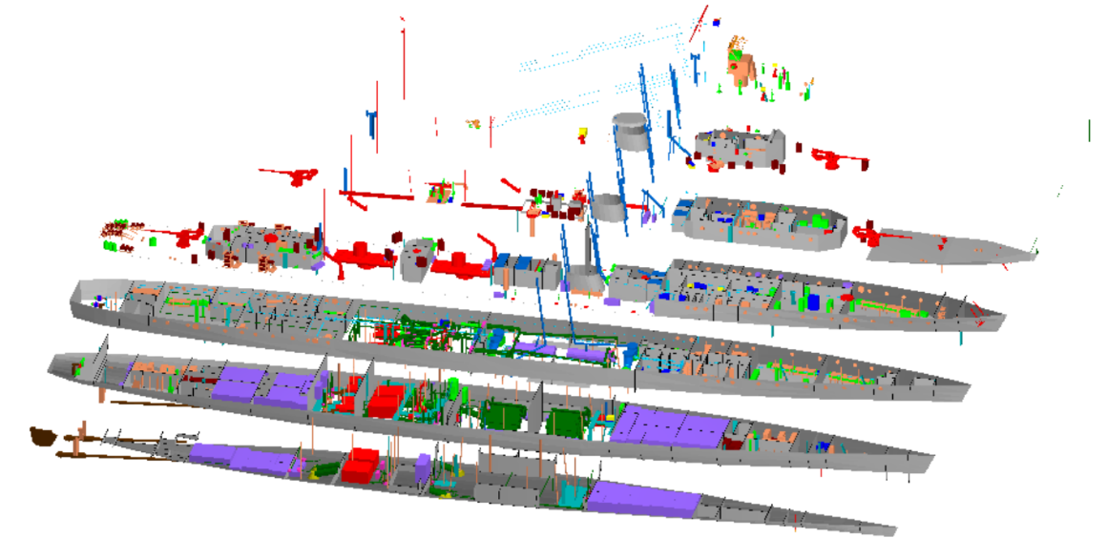
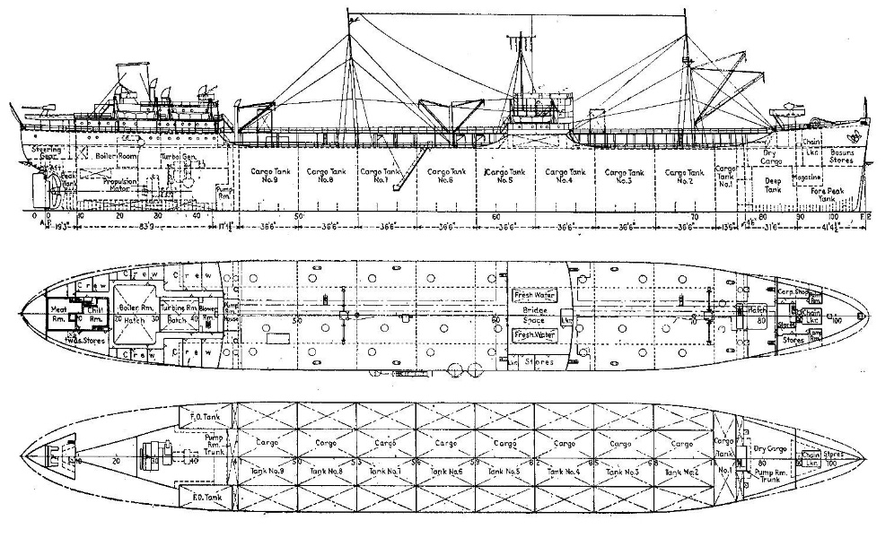
What your company does
SCL
Notes:
Use this slide to explain what your company does and the engineering challenges it faces. Try to connect it to the experiment or the Cardboard Boat Challenge to emphasize problem-solving skills.

Slide 10
Thank you!!!
SCL
Notes:
Thank you slide – invite any questions from students.

